Slide 1

Easy Travels
The best solution for your journey
Group IS07
Project Supervisor : Ms. Kulani Sumanasekara
Project Co-Supervisor :Ms. Gayani Rupasinghe

Slide 2

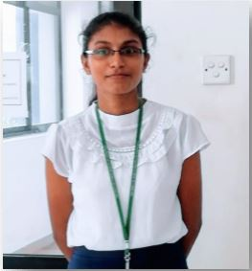
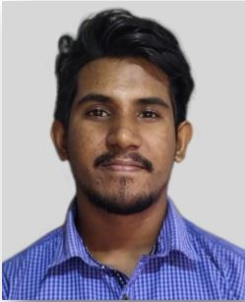
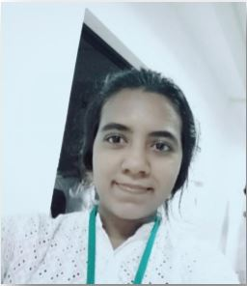
Group Members
Asini Pathmila Silva
18020798
Ruwanthi Hemachandra
18020291
Hansaka Sandaruwan
18020704
Sachini Maneesha
18020356

Slide 3

Easy Travels
The best solution for your journey
Introduction

Slide 4

Introduction
Easy Travels is the solution for traveling issues such as the budget, accommodation, and transportation.
Nowadays people are moving to a digital solution to plan their journey.
So the system provides predefined travel packages to the customers.
According to the selected travel package, the administrator will select the hotel, guide, and vehicle for this journey.

Slide 5
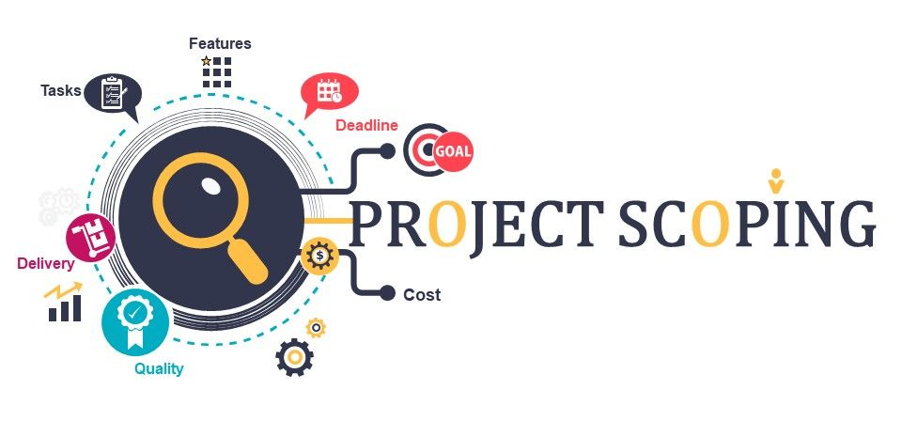
Revised Scope
&
System Architecture

Slide 6

Revised Scope
Considering the boundary activities the first point is our travel packages are predefined.
Users can select travel packages according to their preferences.
So the user can’t select the hotel, guide, or vehicle according to his wish.
Instead, the admin will select the hotel, guide, and vehicle according to the user requirements and the price of the travel package. And also users will be able to put comments, send messages, search travel packages, and view destinations.

Slide 7

The administrator has the authority to add, update, and delete the travel packages, categories, subcategories, and destinations.
The administrator can view the messages which are sent by users. But he uses the manual process to react to those massages.
User, Hotel, Vehicle, and Guide accounts have the authority to change passwords, update and delete their accounts.
The hotel can update availability by changing the number of rooms based on the room’s type daily. The Vehicle and the Guide accounts can update whether they are available or not. We are going to use a sandbox for the payments.

Slide 8

Considering the out of boundary activities, we are not implementing the payment gateway for the payments.
And the administrator doesn’t use the system to organize the journeys. He manually contacts the available hotels, guides, and vehicles according to the user requirements.
And also the administrator doesn’t use the system to react to the user messages.

Slide 9
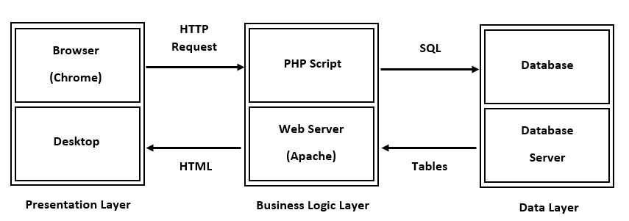
Software Architecture

Slide 10
Presentation Layer
In the 3-tier structure, the presentation tier (layer) is the front end layer and consists of the user interface. This user interface is also a graphical one that can be accessed through a web browser or web-based application and shows information and content that is useful to the end-user. We use technologies such as HTML, JavaScript, and CSS to construct this tier.
Business Logic Layer
The business logic layer (application tier) contains the business functional logic that drives the core capabilities of an application. To create this layer, we used PHP.
Data Layer
The database / data storage system and data access layer are composed of a data layer (tier). To build the layer, we used MySQL.

Slide 11
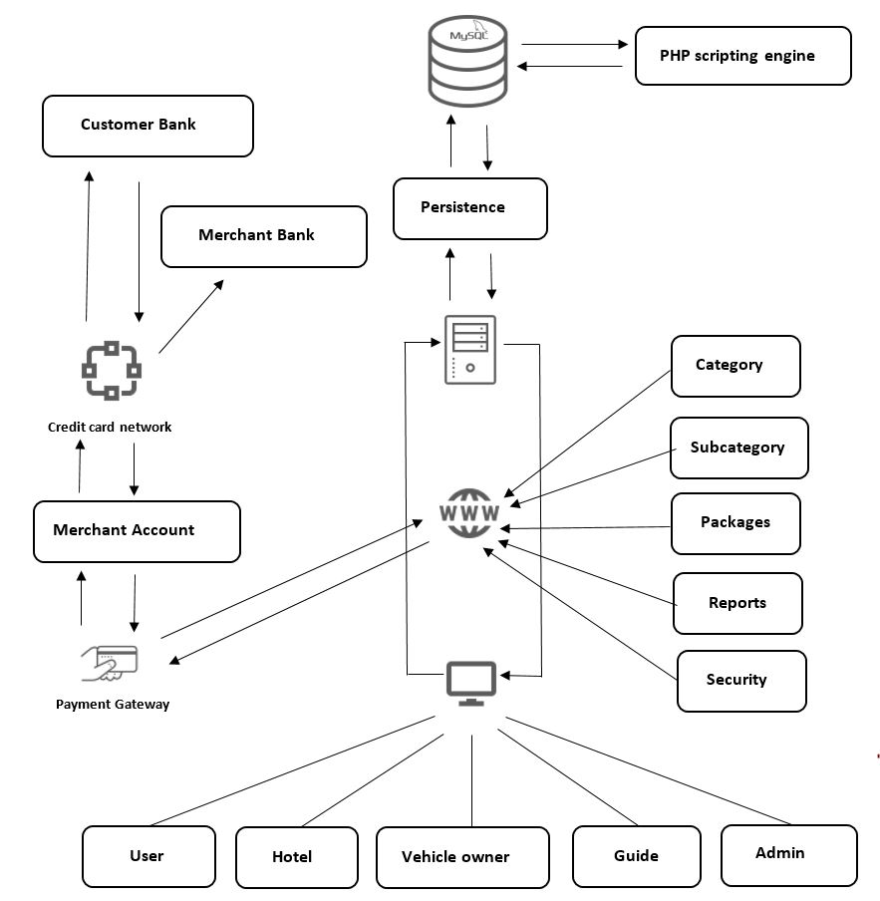
System Architecture
Our system consists of user component, hotel component, vehicle owner component, guide component, admin component, security component, MySQL database component, PHP scripting engine component, persistence component, Apache web server component, payment management component and the booking management component.

Slide 12


What you have done
vs.
remaining work

Slide 13
The work load divided according to the user roles of the system.
Asini – Admin and user roles’ functions
Ruwanthi – Hotel user role’s functions
Hansaka – Guide user role’s functions
Sachini – Vehicle user role’s functions
No | Task | Asini | Ruwanthi | Hansaka | Sachini
1 | Requirement gathering | done | done | done | done
2 | Designing diagrams | done | done | done | done
3 | Creating SRS Document | done | done | done | done
4 | Designing database tables | done | done | done | done
5 | Designing proto-type interfaces | done | done | done | done
6 | Implementing interfaces | done | done | done | done
7 | Connecting to the database | done | done | done | done
8 | Arranging codes based on architecture | done | done | done | done
9 | Adding validation parts | not yet | not yet | not yet | not yet
10 | Doing testing | not yet | not yet | not yet | not yet

Slide 14
Progress
Admin Module
Interfaces | 100%
CRUD operations | 100%
Validation parts | 40%
Registered User Module
Interfaces | 100%
CRUD operations | 100%
Validation parts | 40%
Not Registered User Module
Interfaces | 100%
CRUD operations | 100%
Validation parts | 30%
Hotel Module
Interfaces | 100%
CRUD operations | 100%
Validation parts | 30%
Guide Module
Interfaces | 100%
CRUD operations | 100%
Validation parts | 30%
Vehicle Owner Module
Interfaces | 100%
CRUD operations | 100%
Validation parts | 30%
Authentication Module
Interfaces | 100%
PHP operations | 100%
Validation parts | 100%
Report Generation Module
Interfaces | 100%
PHP operations | 100%
Validation parts | 100%

Slide 15

Remaining works
Finish the validation parts.
Finish the testing parts.
Validation
Admin Module | 60%
Registered User Module | 60%
Not Registered User Module | 70%
Hotel Module | 70%
Guide Module | 70%
Vehicle Module | 70%
Testing
Unit testing | 100%
Integration testing | 100%
System testing | 60%
User Acceptance testing | 100%

Slide 16
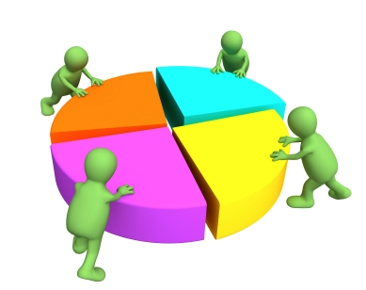
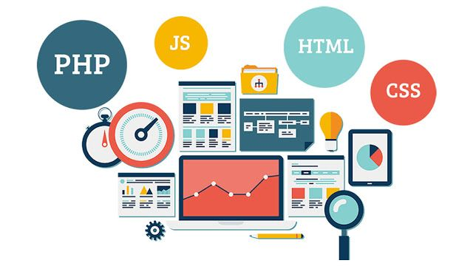
Experienced & learned technologies

Slide 17

Experiences
Benefits of involving in a teamwork
Working as a team together creates more new ideas and innovation. We share our creative ideas as we develop our website's user interfaces.
Teamwork increases the project's effectiveness and brings better outcomes.
It increases morale and inspiration.
Encourages risk-taking and the easy and best choices.
We happen to face different issues often. We have to take the risks at that moment to get the fastest and safest solutions.
It raises the tension when we do this 2nd-year project individually. Yet tension is minimized because, as a team, we do this one.

Slide 18

Team Challenges
Due to its difficulties when collecting as a group and lack of physical presence, and its criteria for skills in managing technology, human relationships, and content-related tasks, online group work is complicated.
Strategies on how to streamline online group work management, how to minimize unnecessary and required requirements and the expected system's logic and coding, and how to strengthen online group work.
Complete an online interim presentation using Zoom Technology as a community. There are some difficulties with connecting and preparing the progress of the presentation occasionally. To overcome the issues, you have to find a solution.
As a group, when considering the members of the group, there is not the same coding experience. So we need to code for the project for all the participants with the same language set that is familiar to them.
We could not physically touch each other in the Corona situation, so we use Zoom technology and what's Social Media app for touch with each other members and use Gmail and Github as the corroboration tool.

Slide 19





Technologies used
Front End
Back End

Slide 20
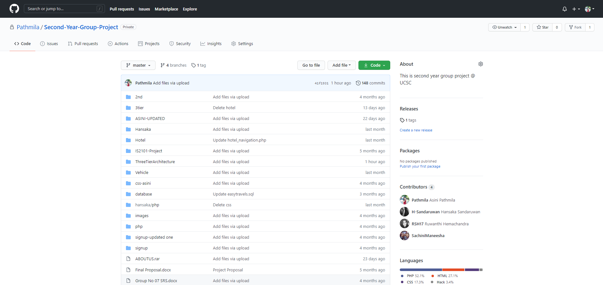
Contribution Platform – GitHub

Slide 21

Course Mapping
Under the IS1109-Programming For Web Applications Development Subject, we studied HTML, CSS, JavaScript and PHP. While we are doing this Community Project, we have learned and practiced certain technologies. And we also basically learned and experienced how to use CSS to draw maps.
We have basically used what we have learned under IS1110-Database Management Topic when building databases using MYSQL and drawing EER Diagram.
We learned about software development methodologies such as how to draw class diagram, sequence diagram, part diagram, and operation diagram under the IS2101-System Analysis and Design subject. Those diagrams are basically used while our project is being created. And we also chose a Process Model that we used to learn from this subject. Not only that, we used what we learned through the topic of IS1111-Software Engineering and we use the material of this topic when we do the testing portion.

Slide 22
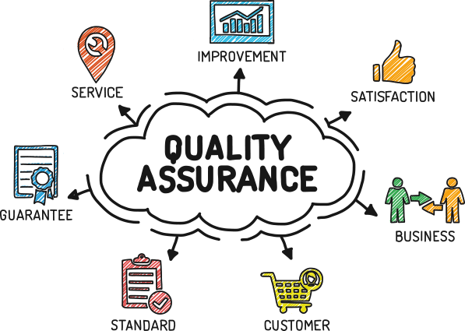
Quality Assurance

Slide 23
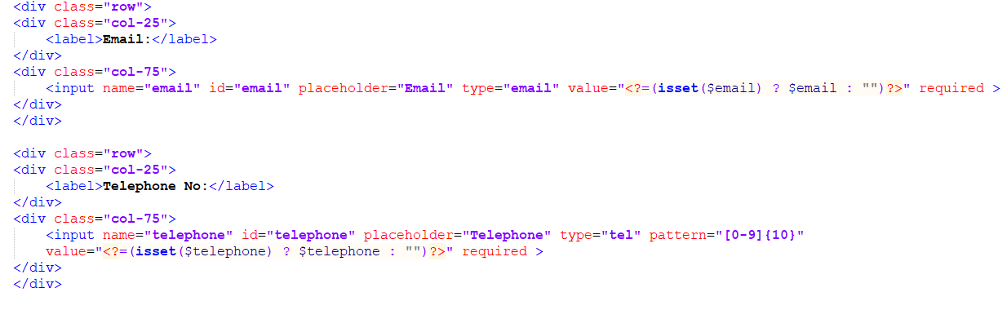
External Quality
Accuracy
The system is related, spelling errors or missing material are not present.
The meta data and the title tags are on all the web pages.
The system is built with features such as drop-down boxes to reduce errors that users can make.
Inputs such as telephone numbers, addresses, numbers etc. will be auto-validated.

Slide 24
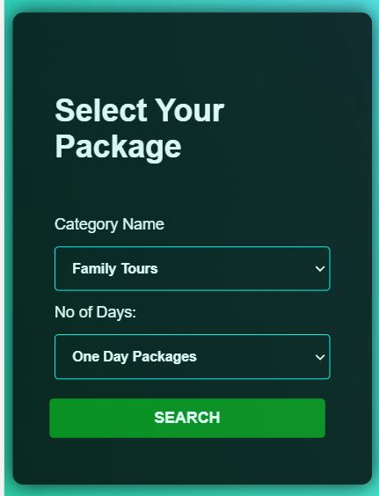
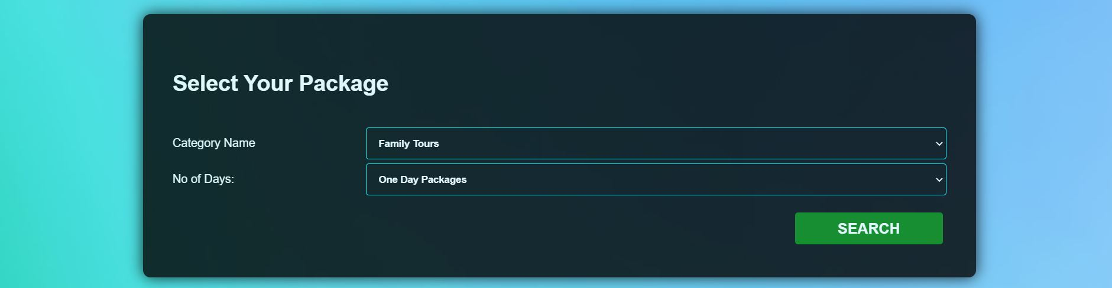
User friendliness
Mobile Compatibility
Contrasting Colour Scheme
We are going to use the feed back from user after they did the user testing.
Usable Forms
Use correct labels for all fields
Follow good form design principles
Try to keep the number of fields to a minimum
Offer tooltips and suggestions
Display on-screen message on completion
Use correct validation

Slide 25
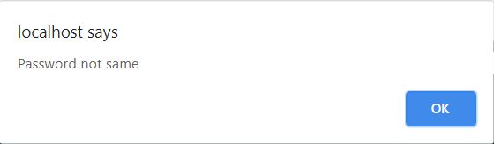
Good Error Handling (Error Messages)
Effective Navigation

Slide 26
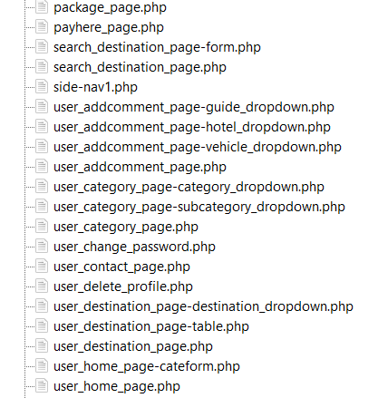
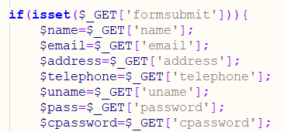
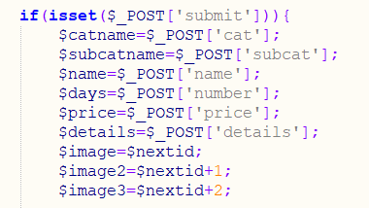
Internal Quality
All the codes reviewed by group members.
Clarity and Consistency
The naming convention includes PHP, HTML, CSS files, variables and functions that can be readable and easily understood.

Slide 27
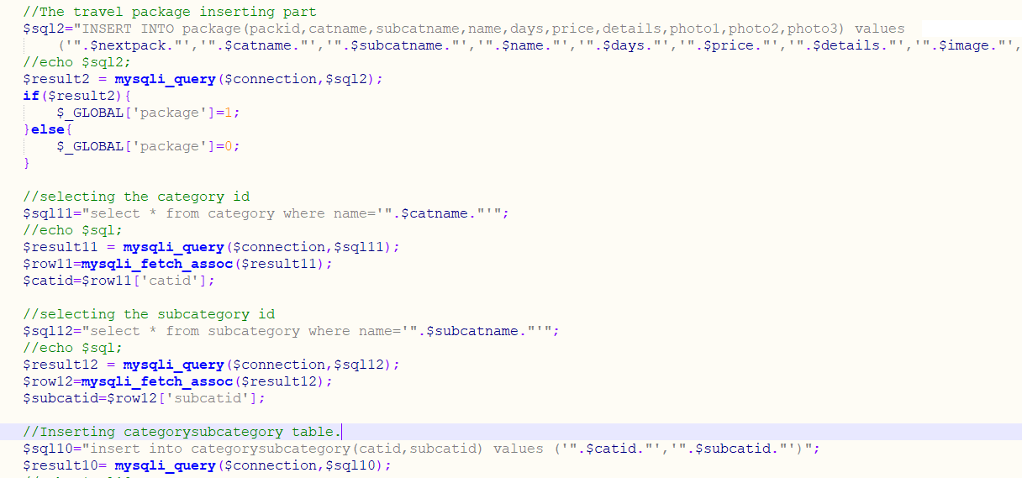
Understandability
For defining codes, clear and meaningful comments were used.

Slide 28
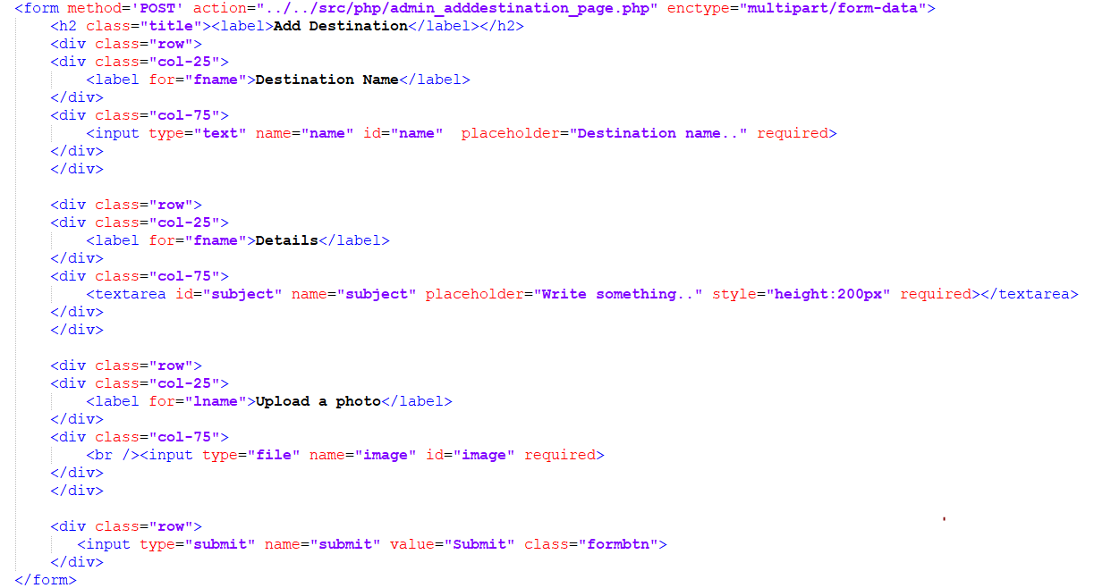
Validation techniques
To enhance the user experience, front end validation is allowed, providing instant feedback.

Slide 29
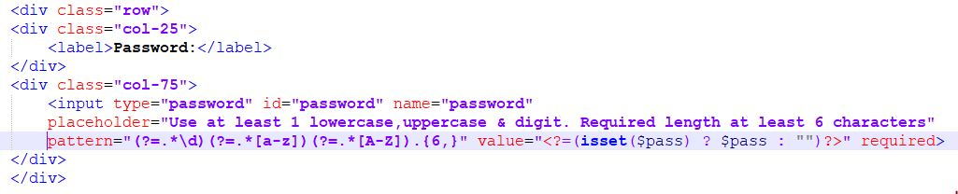
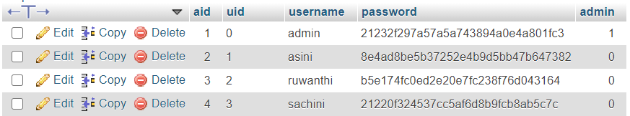
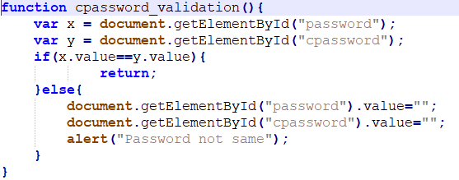
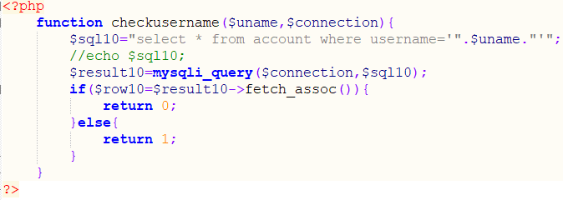
The user has to enter the strong password. The password required at least one number, one uppercase and one lowercase. The required password length should be at least 6 characters. Those passwords will be stored in encrypted manner in the database.
The consistency of user inputs such as the user name and password is also supported for backend validation.

Slide 30
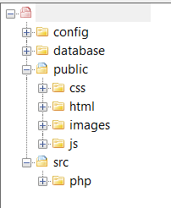
File hierarchy
All the files are saved according to the architecture of the three stages.
In the config folder we stored the database configuration files. In the public folder we used to save the presentation layer files, such as HTML, CSS, JavaScript and images. We saved PHP files which are related to the business logic layer in src folder.

Slide 31
Testing Process
We are going to use manual testing.
The tested parts.
User authentication (Login, Logout)
User signup
Admin report generation part
User input validation
User interface navigation
Unit testing | Done
Component testing | Done
System testing | Still Doing
Acceptance testing | Not Yet

Slide 32

Development Plan

Slide 33
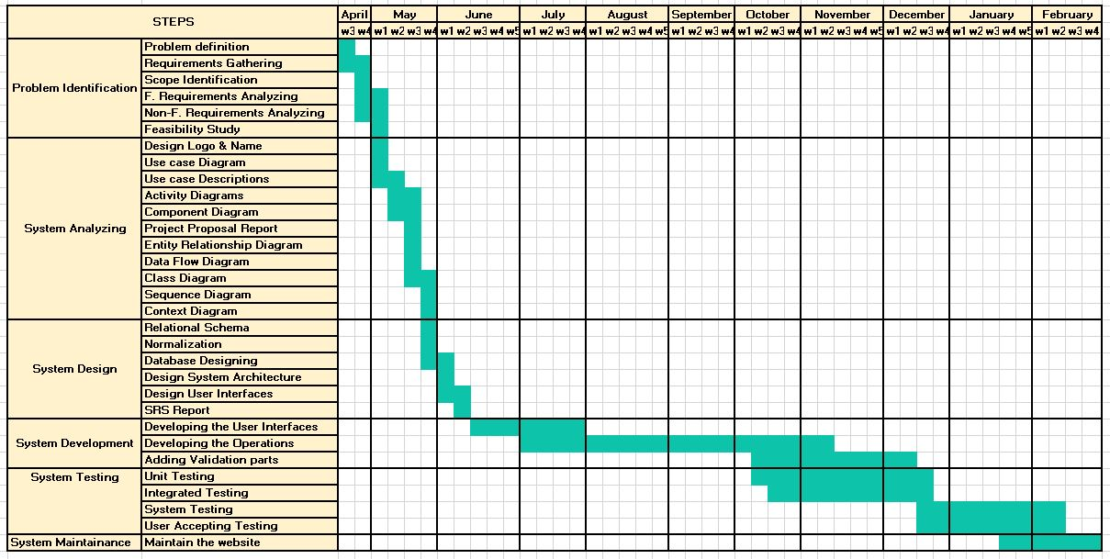
Development plan

Slide 34

Deployment Plan

Slide 35
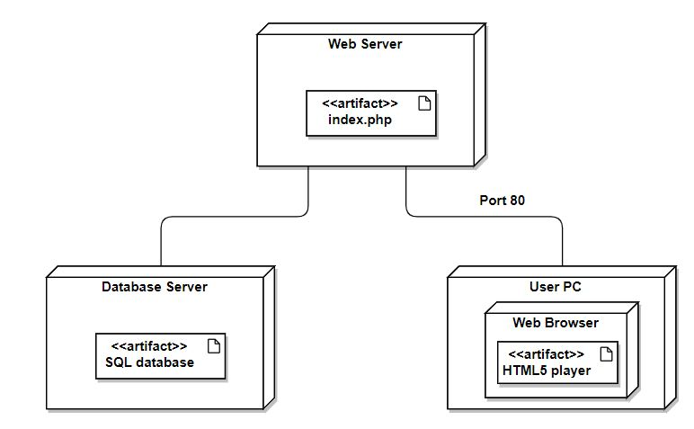
Deployment plan
We will deploy the system after we finished all the modules.
This is the deployment diagram for our system.

Slide 36
Thank You.

Slide 37
Functional Requirements

Slide 38
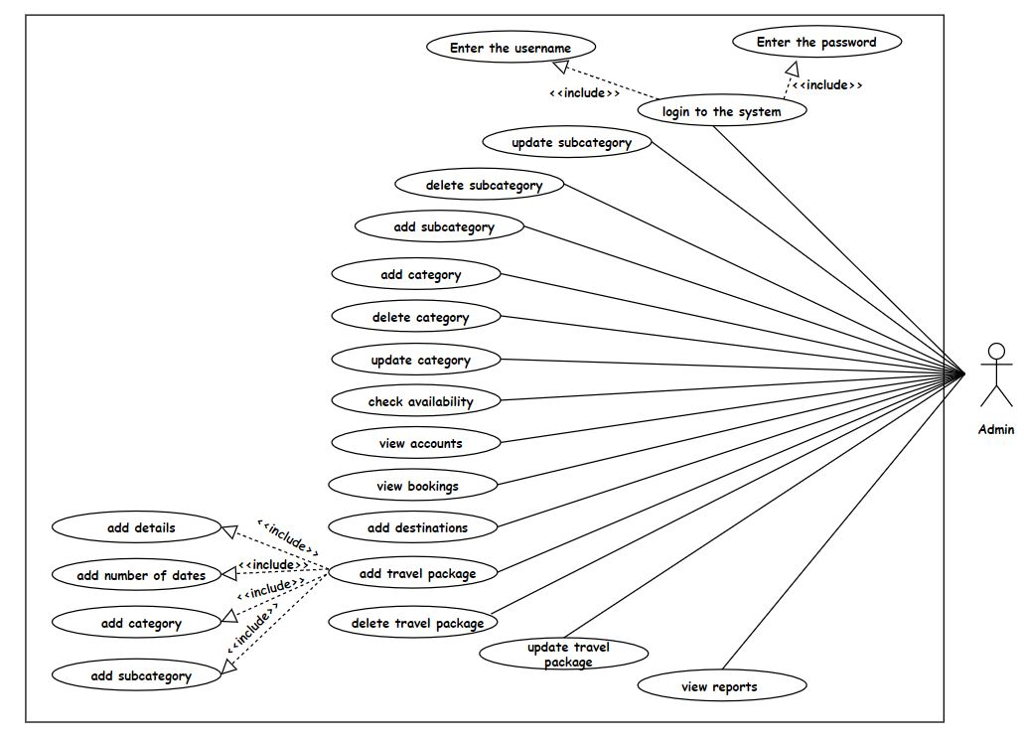
Admin

Slide 39
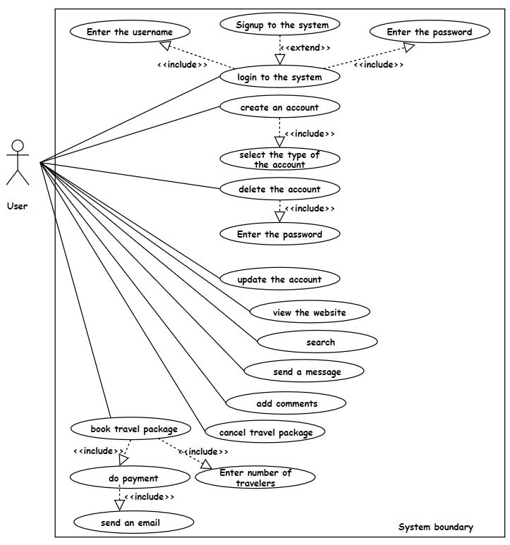
User

Slide 40
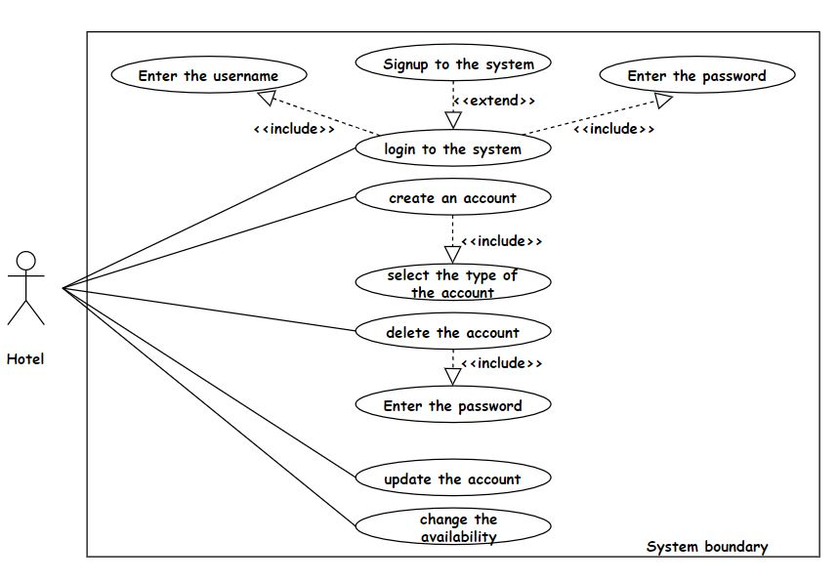
Hotel

Slide 41
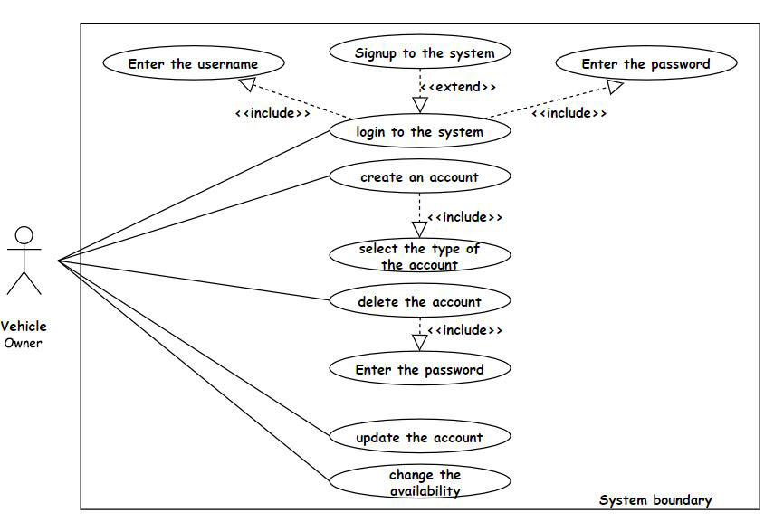
Vehicle user

Slide 42
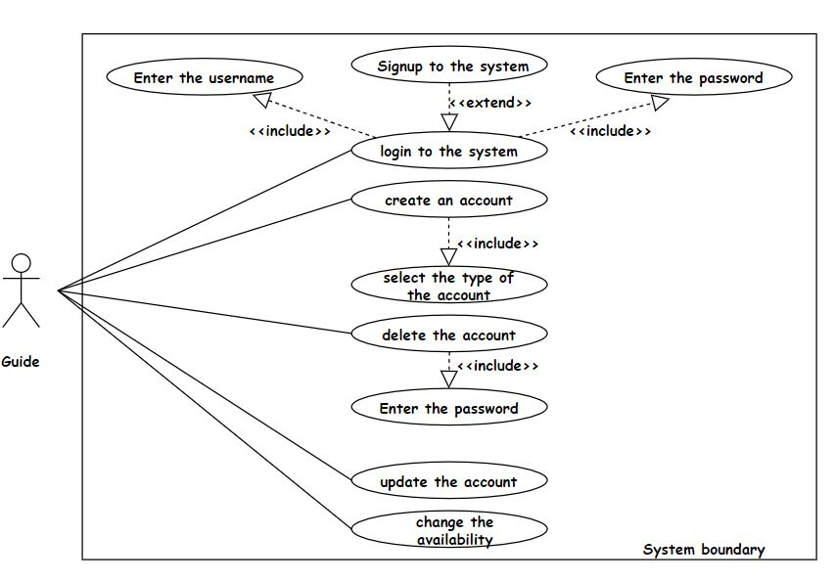
Guide

Slide 43
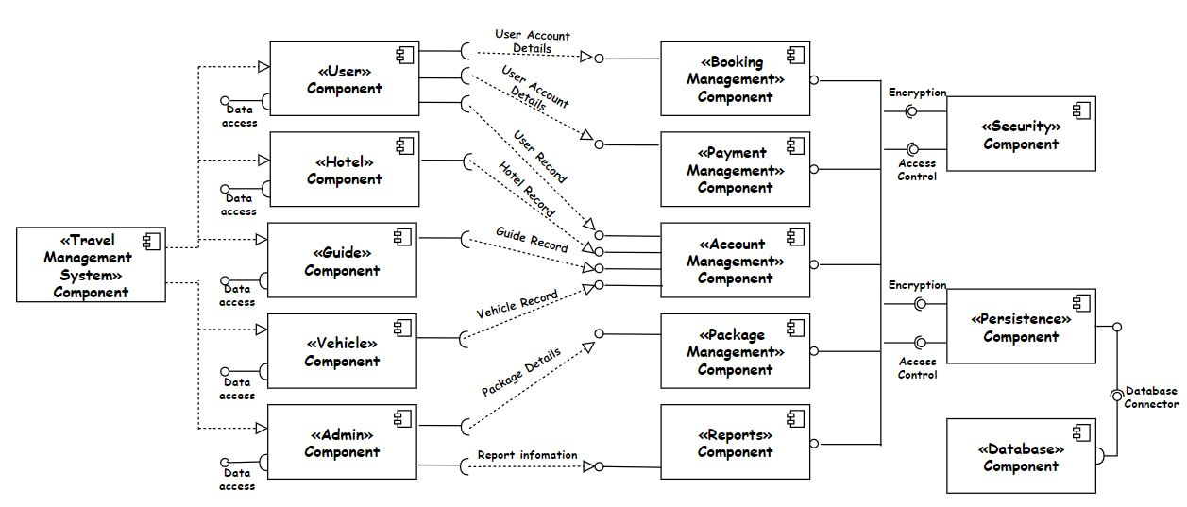
Component Diagram

Slide 44
Components and their responsibilities
Component | Responsibility
User | Register to the system. Book the travel packages Add comments and ratings. Send messages to the administrator. Do the payment for booked travel packages. Maintain his profile.
Hotel | Register to the system. Change the availability of the hotel rooms daily. Maintain his profile.
Guide | Register to the system. Change the availability of whether he is available or not by daily. Maintain his profile.
Vehicle owner | Register to the system. Change the availability of whether the vehicle is available or not by daily. Maintain his profile.

Slide 45
Admin | Maintain travel packages including categories, subcategories, and destinations. Check availability and assign the hotel, vehicle, and guide for the booking. Check reports.
Security | Enables safe operations. Protects data the organization collects and uses
MySQL database. | Stores and retrieves data.
PHP scripting engine | PHP script code embedded in the web page is invoked to request data from the MySQL database. Data returned by the MySQL database is proceeded by the PHP script to customize the web page.
Persistence | Realizes store and retrieve functionality for supported services. Generates a scheduler for each supported service to partition data to suitable database back-ends.

Slide 46
Apache web server | Establishes a connection between a server and the browsers of website visitors. Delivers files back forth between client and server.
Payment management component | The payment gateway used to make the payments that are done by the user. It is authorized transactions between Easy Travel Company and users.
Booking management component | Stores bookings which are done by the user Update the bookings after user cancel a booking
Report management component | Preview the reports according to the data in the database.

